Slide 1
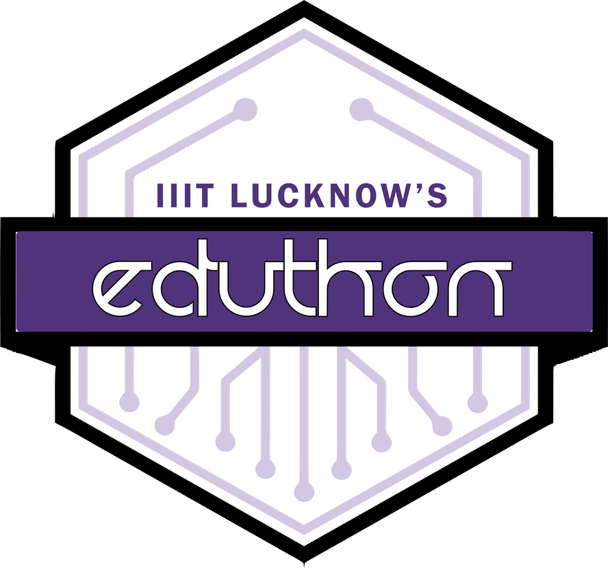

Meridio Chain
You Own Your Idea
Team Code Busters
Aavishkar Mishra
Adittya Dey
Rabijit Singh
Subhasish Goswami
EDUTHON-EDUCATION THEMED HACKATHON
01

Slide 2
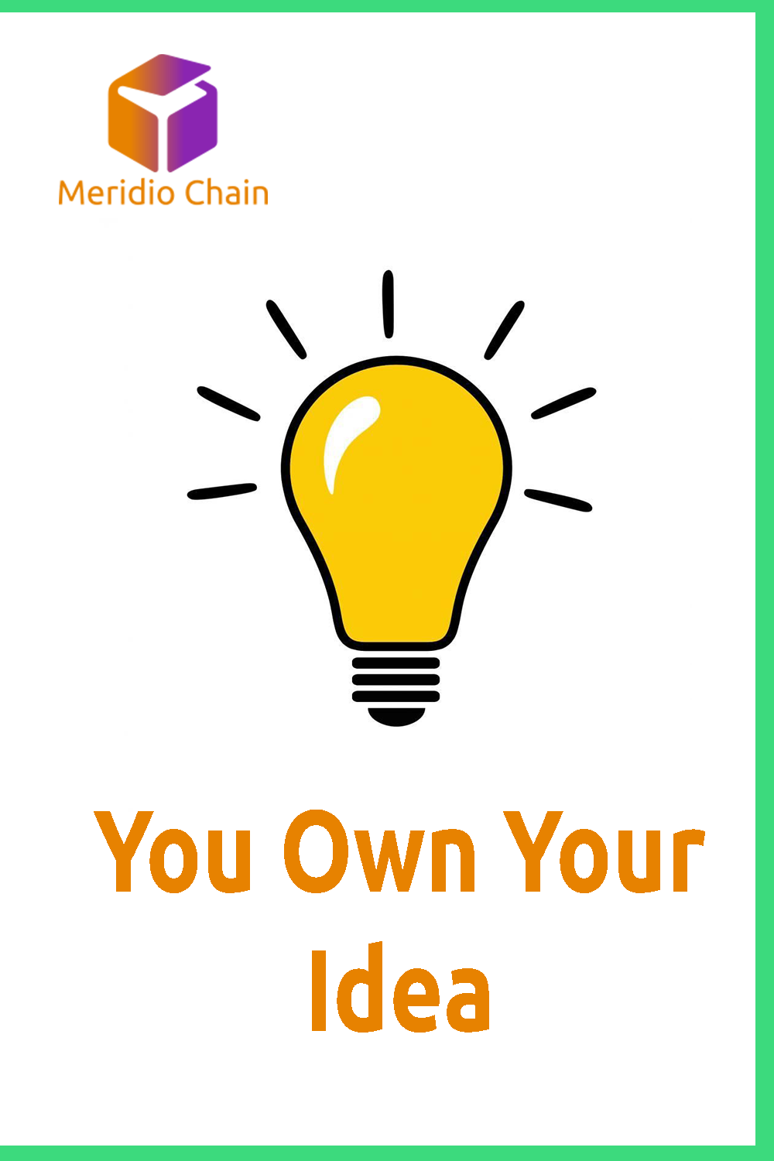
PROBLEM STATEMENT
We love making new projects and working on new ideas. During the current scenario of online classes what we miss the most is constant support of our teachers and professors. Imagine having a noble idea which you can't find on the internet but after working with your full dedication on your idea, you find that someone has already worked on the idea and published his work in a foreign language journal.
Even after you implement your idea, patenting something in India takes 4 to 6 years. Moreover the process is long enough to make it impossible for new ones to complete without any support from previously experienced professionals..
There needs to be a platform where one can share their research and project idea so that others can check if someone is working on idea before they can start. The platform needs to store data in an immutable manner so that if there is any day some issue regarding ownership of the intelectual property records can be checked to ensure who came up the idea first.

Slide 3
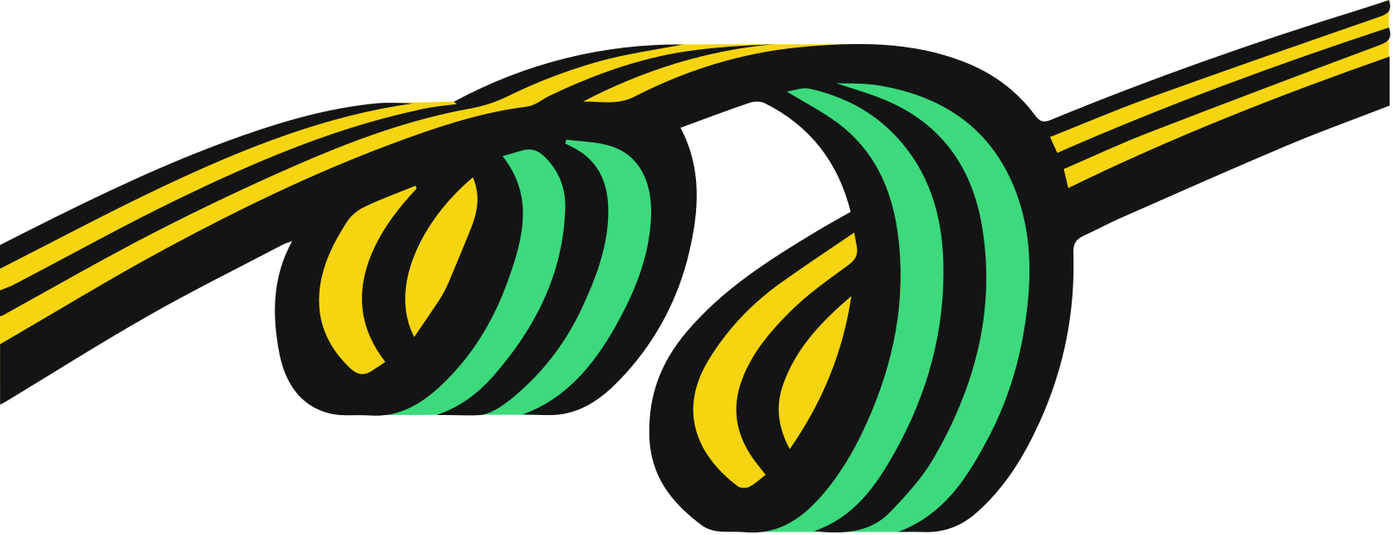
PROPOSED SOLUTION
We present to you Meridio Chain. Meridio means to share in greek and as the name suggests we present a Distributed APP to share, to share your ideas.
We propose a solution based on Ethereum blockchain to post project and research ideas by the users. Ideas will be stored on the Ethereum blockchain network in order to maintain immutability. Data will be stored on the Ethereum blockchain by smart contracts written in solidity through transactions. User’s unique ethereum address is fetched using Web3js and it is used as an unique key to retrieve complete profile details from MongoDB database. Apart from checking if someone is already working on a project idea, users can also support other projects by sending ethereum to author’s ethereum address. Under My profile users can check their profile details and also previous posts made by them.
Using the solution users can look if someone is already working on their idea and if not they can post their idea. Users can support other projects or even contact authors of various projects.

Slide 4
Project Structure
We basically have two separate repositories.
The first repository does the job of presenting the user with an interface to View, Post ideas and to manage his/her profile. We are storing the post data in the Ethereum Blockchain using Solidity and we fetch the data using Web3JS when we want to show it. The interface is built with ReactJS which provides us with a smooth UI. We are storing the user data in a MongoDB database using API calls. This enables us to maintain a Profile section in the Distributed APP.
The second repository does the job of handling API calls from the Web App and acts as a server for dealing with the user data. The APIs were made using Flask and the data is stored a MongoDB online cluster. We have hosted this repository on Heroku which makes API calls easy from the app. The Server has mainly 5 API functions to fetch all users, fetch a particular user, add a new user, update a user and delete a user.

Slide 5
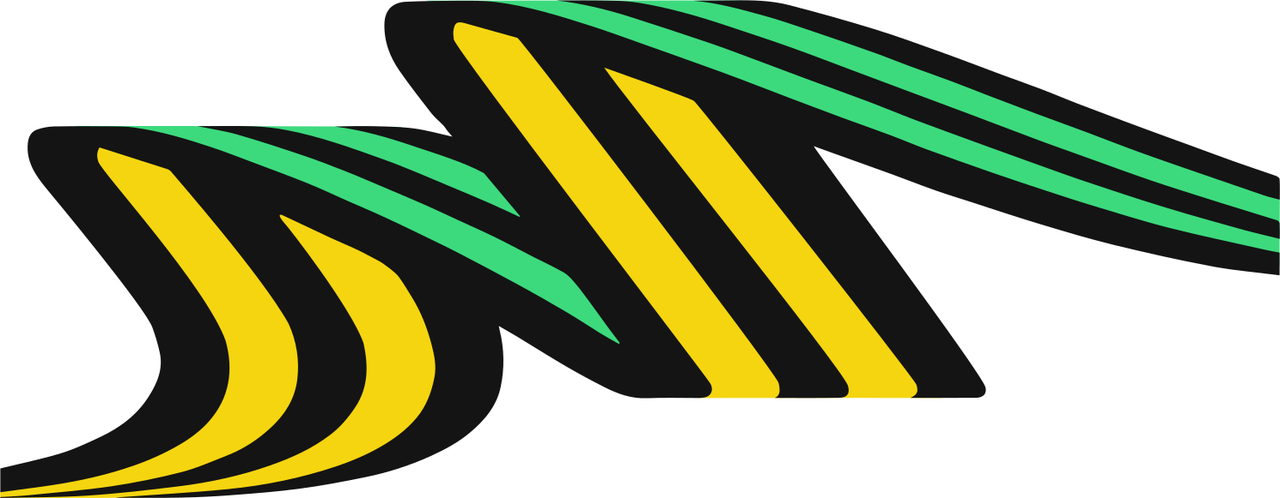
UNIQUE SELLING POINTS
1. Ease of Use
Anyone connected with the Ethereum Network using a wallet can make a profile and start posting
2. Immutable in Nature
User’s data is stored on blockchain hence no one can change the details and users don’t need to worry of people copying their ideas
3. Need for Users
There is need for platforms where users can check if someone is already working on an idea.

Slide 6

TECH STACK
1.
ReactJS
Front end and user interface has been rendered using React and it’s various components
2.
Web3JS
Smart contract data have been fetched using web3js. User Interface interacts with the smart contracts through web3js.
3.
MongoDB
Details related to user profile are stored on the MongoDB database
4.
Solidity
Smart contracts have been written in solidity programming language
5.
Flask API
flask has been used to make rest API

Slide 7
THANK YOU

